Slide 1
Machine Learning Gen-Z College Admission Rates
By Jhair Morales, Raul Moreno

Slide 2

Problem Statement
The purpose of this project is to create a machine learning model capable of predicting the outcome of a college admission. Focuses solely on the Gen-Z generation (1997 – 2012).
College admissions are influenced by many factors, mostly academic.
By predicting what factors are contributing to admission acceptance, schools can help support students towards academic success.
This project researches which machine learning models performs best.

Slide 3
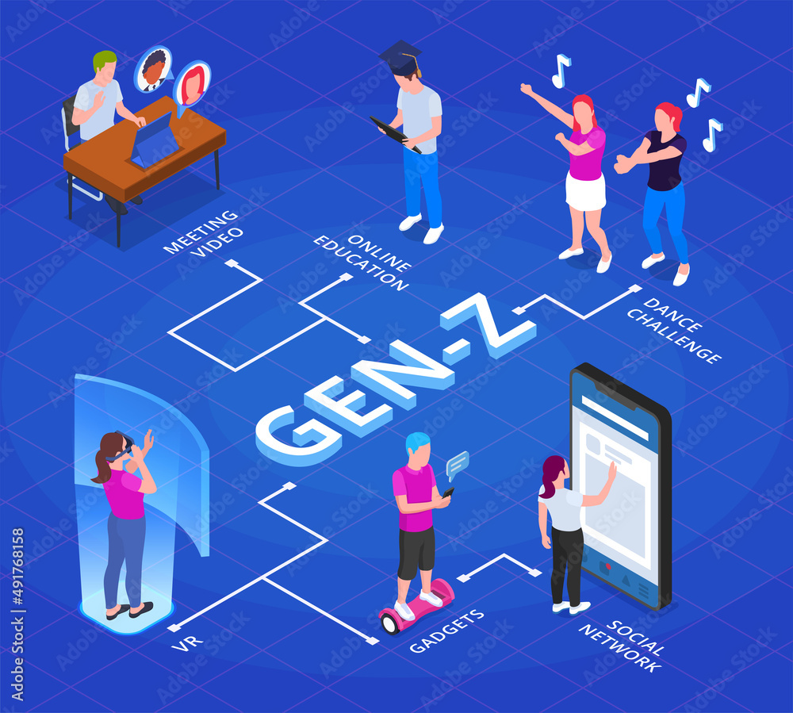
Dataset Overview
Data obtained from Kaggle, over 1 million student records.
Surveys students in academic and personal factors such as
State
Family Income
High School GPA
Attendance
SAT/ACT scores
Social Media Hours
Online Certifications
Extracurricular/Volunteer activities

Slide 4
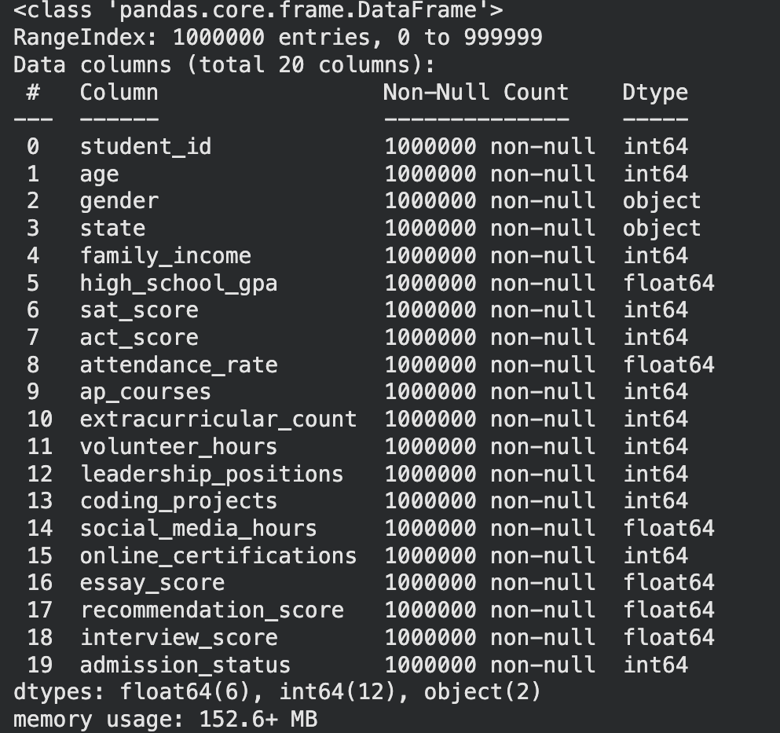
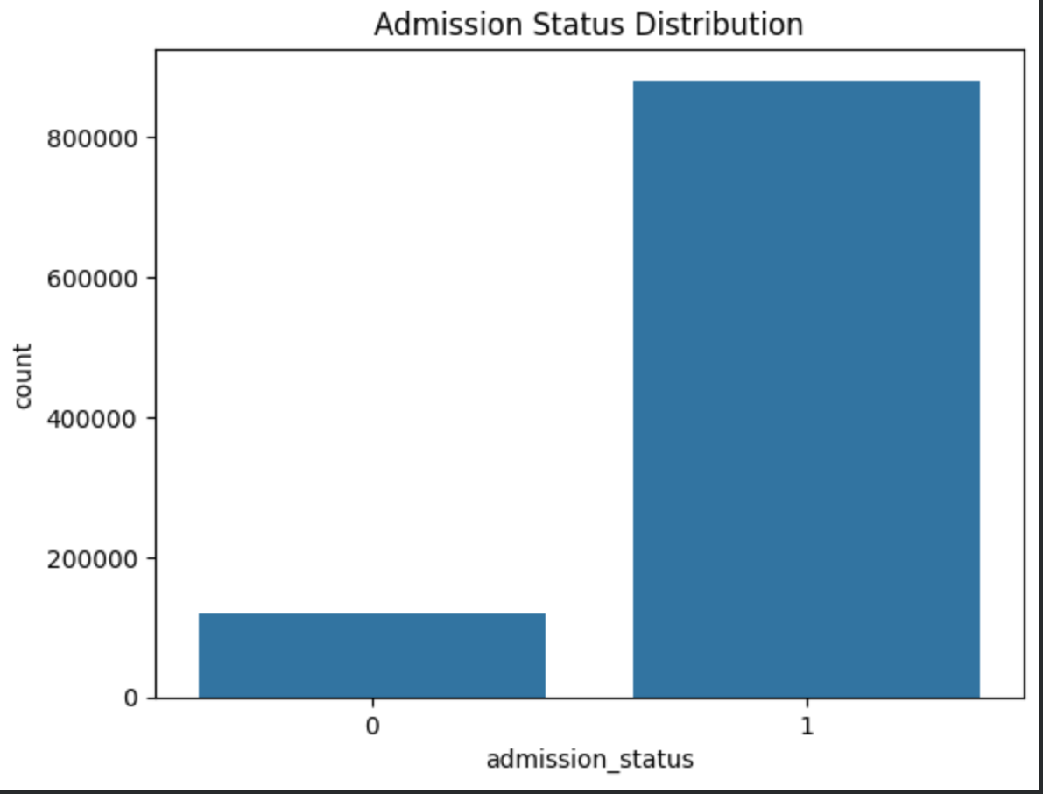
DA Findings
Data obtained from Kaggle shows an inconsistency of admission status distribution.
All data is full with no missing information

Slide 5
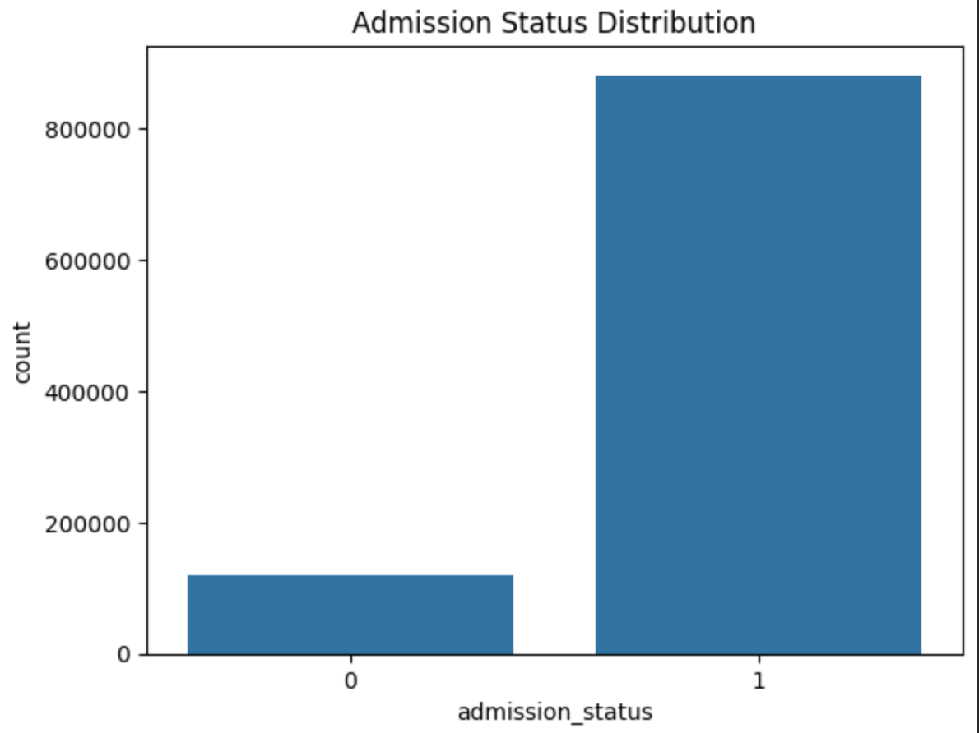
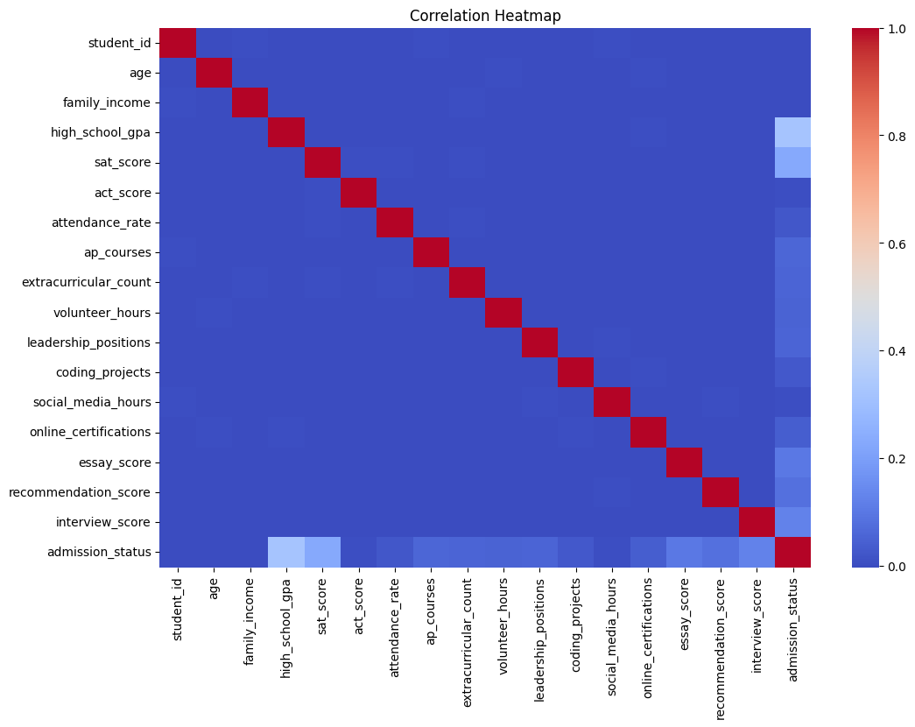
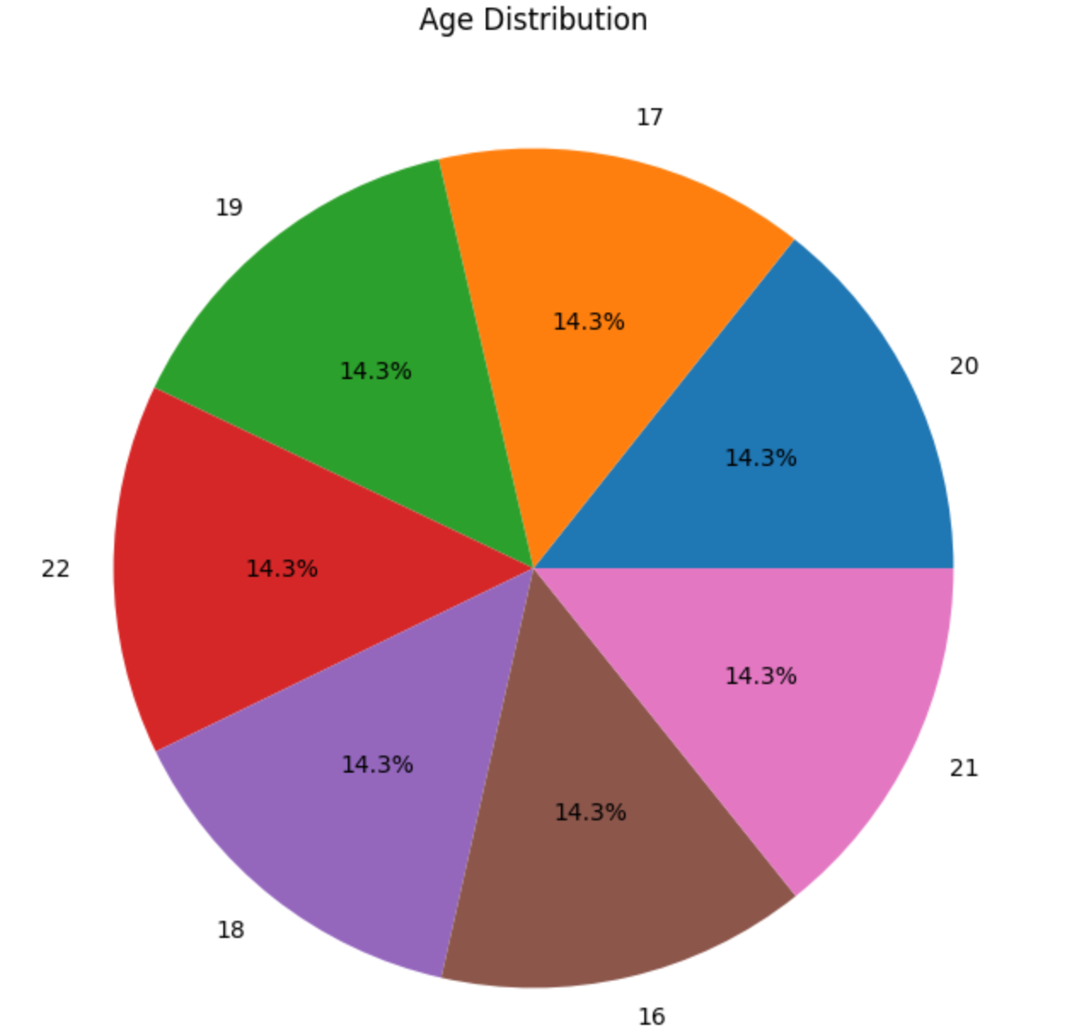
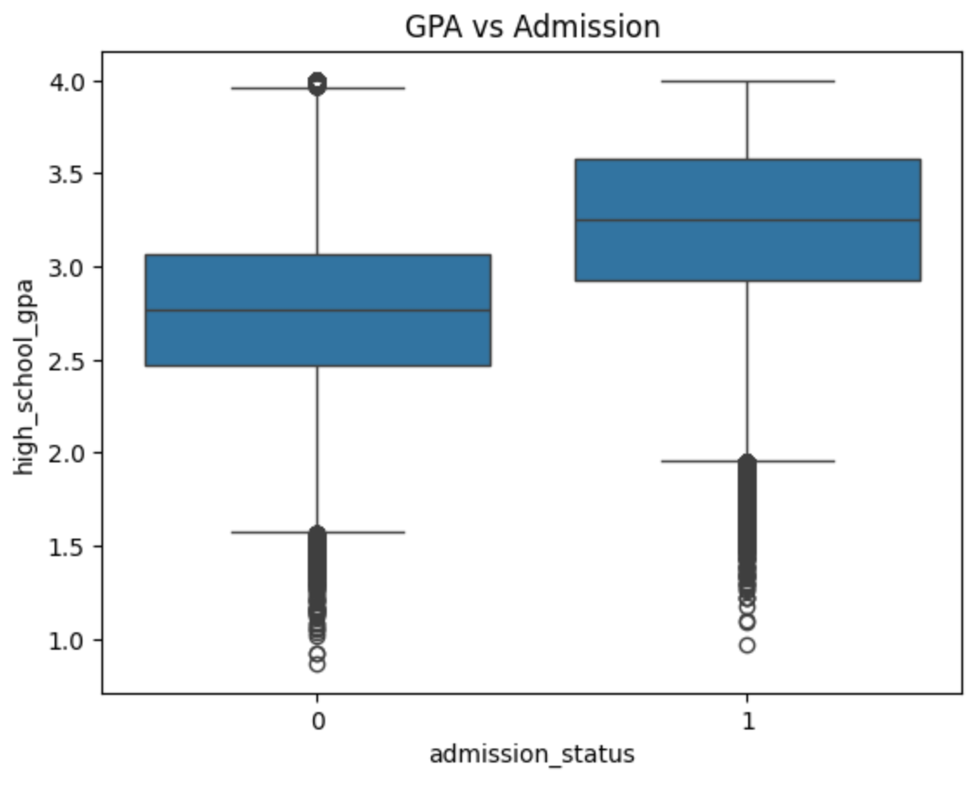
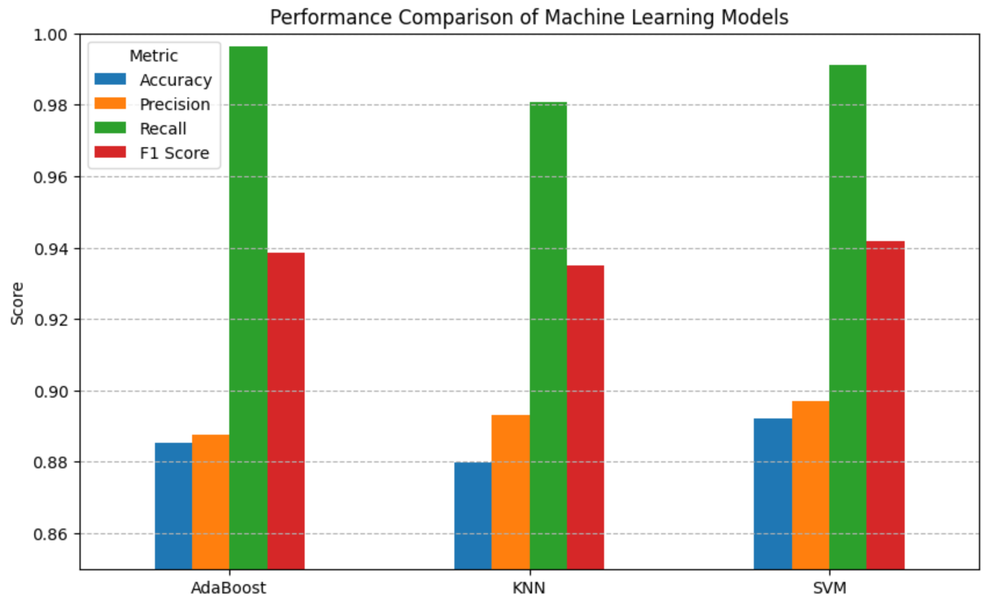
Visualizations

Slide 6
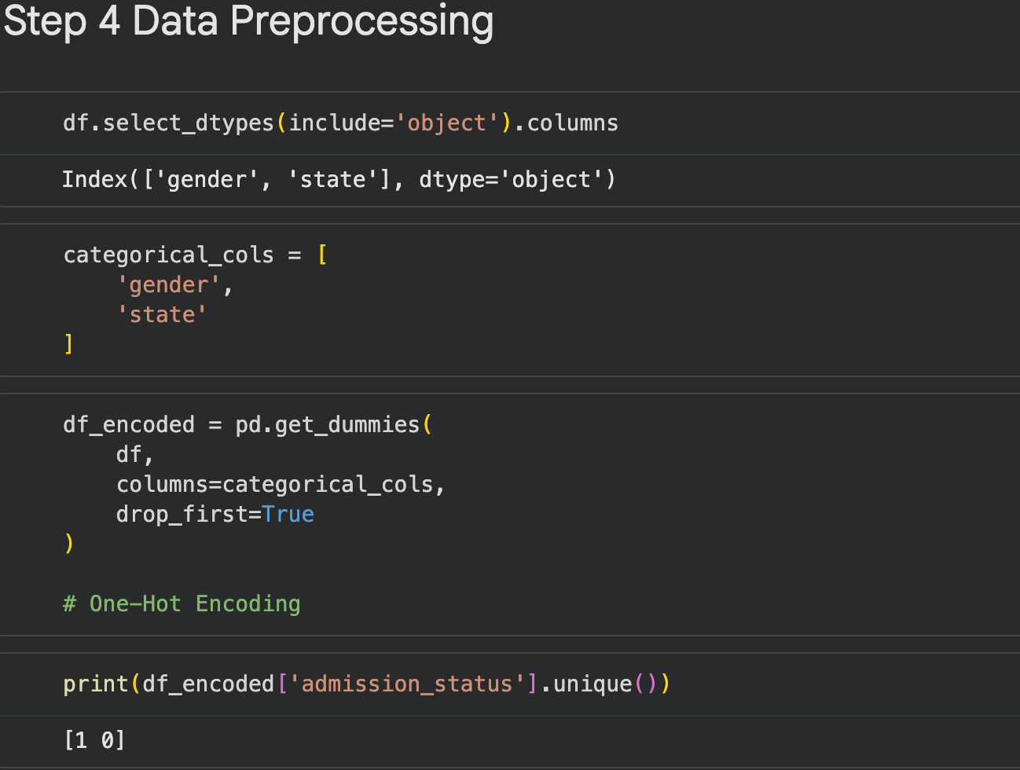
Data Preprocessing
Identified two categorical features: Gender & State
Target variable: admission_status
Sampling was scaled down to 50,000 for KNN& SVM due to the large data size

Slide 7
Classifiers
KNN
Classifies students based on similarity to other students.
Uses the 5 nearest neighbors (K=5) to make predictions.
Simple and easy to understand.
Works well when similar students have similar admission outcomes.
SVM
Finds the optimal boundary separating admitted and rejected students.
Maximizes the distance between classes to improve prediction accuracy.
Effective for complex classification problems.
Achieved the highest overall performance in this project.
AdaBoost​
Combines many small decision trees into one
Focuses on correcting previous decision tree mistakes ​
Uses weighted voting to make decisions
Achieves the highest recall among other models

Slide 8
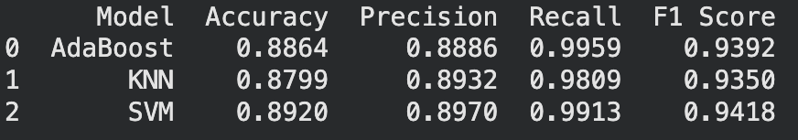
Results
All 3 models achieved over 87% accuracy
SVM achieved highest accuracy, precision & f1 score
AdaBoost achieved the highest Recall
KNN is slightly less accurate than SVM & AdaBoost

Slide 9
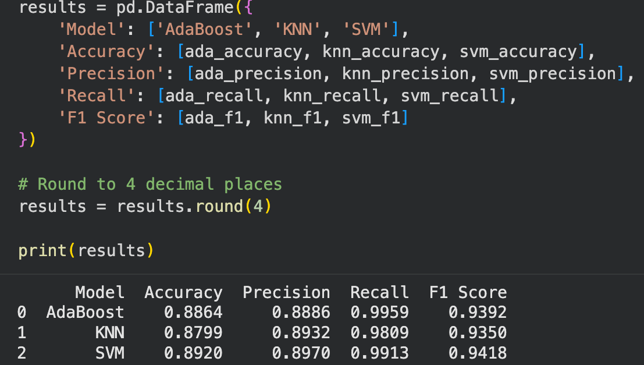
Comparisons

Slide 10
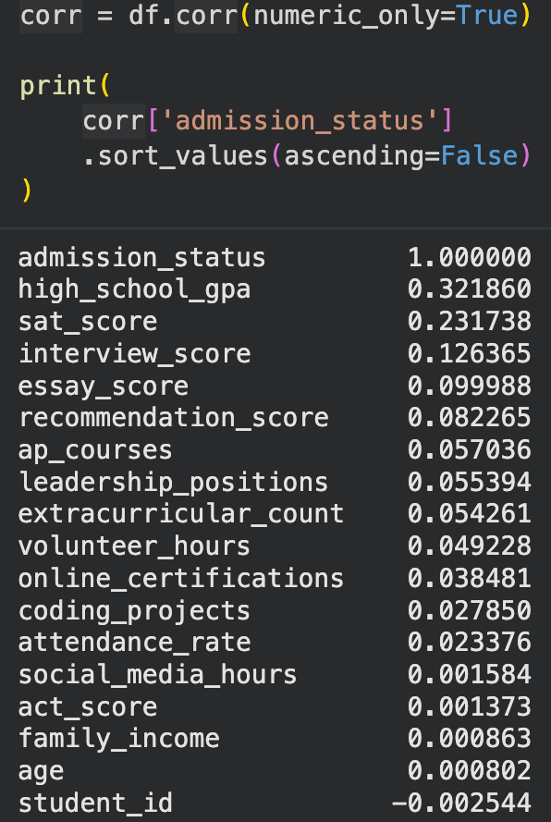
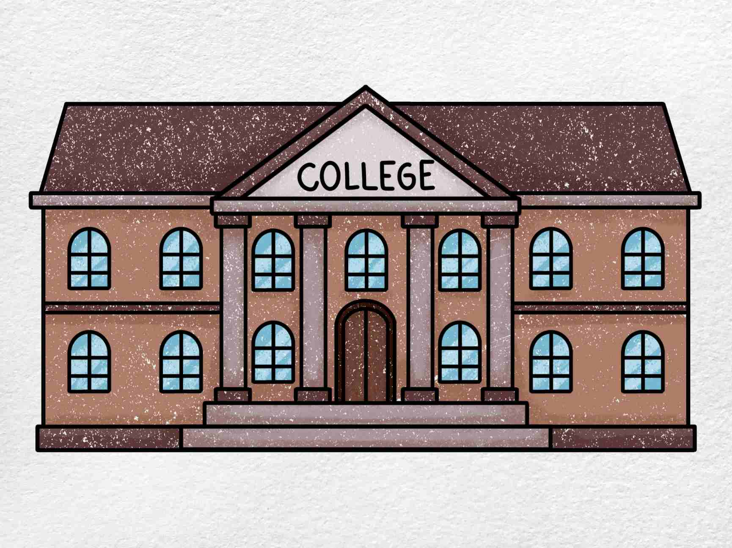
Conclusion
Machine learning can be utilized to predict the admission outcomes for college applicants
AdaBoost was best at identifying admitted students
Students who perform better in school such as in High School GPA,SAT scores, essay scores, recommendation score, interview score & AP Courses

